Slide 1
Web Design Fundamentals /
Basic Web Design
Web Forms – ITEWEBDES

Slide 2
Designing Web Forms
Describe Forms HTML tags
Forms provide a means of submitting information from the client to the server.
Design forms with:
Text Field
Radio Button
Popup Menu & Scrolled List
Checkbox
Text Area
Submit and Reset buttons
Use of scripts for processing input data
Send output results by email and save them into a file

Slide 3
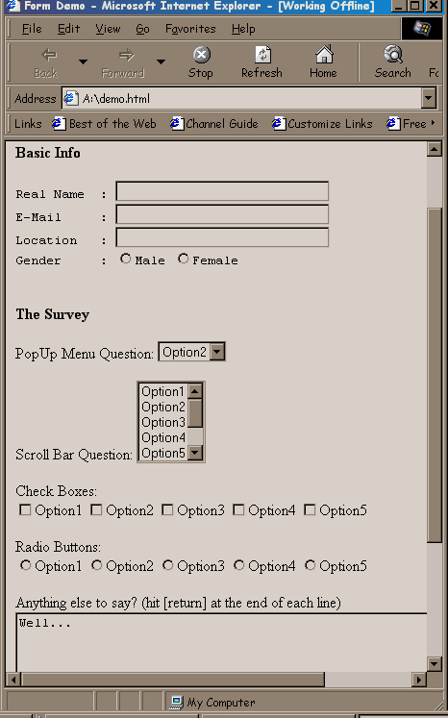
Text box
Radio button
Popup menu
Scroll box
Check box

Slide 4
Forms in HTML
In a form, different types of inputs are used.
Processing inputs to collect data is done using CGI Scripts (Common Gateway Interface).
<FORM ACTION="sendform.cgi“ METHOD="post“ >
The Action attribute specifies the program that will interpret and process the data collected when the user submits the data. The resulted output could be sent via email, or saved into a file, or both.
The Method attribute states how the data collected is to be transmitted (GET or POST).
</FORM>

Slide 5
ALL ABOUT FORMS
The <FORM> tag starts the form.
A document can consist of multiple forms, but forms cannot be nested;
a form cannot be placed inside another form.

Slide 6
The ACTION attribute
It specifies the URL of the CGI program that will process the form information.
Notes:
A CGI program is any program designed to accept and return data that conforms to the CGI specification. The Common Gateway Interface is an agreement between HTTP server implementors about how to integrate such gateway scripts and programs.

Slide 7
The METHOD attribute
It specifies how the server will send the form information to the program.
POST sends the data through standard input, while GET passes the information through environment variables. If no method is specified, the server defaults to GET.

Slide 8
Creating a Text Field
Syntax: <INPUT type=”TEXT” …..>
Example:
<HTML>
<TITLE> Working with Forms </TITLE>
<BODY BGCOLOR="lightyellow">
<FORM>
<B><font color="blue"> Class Information</font></B>
<label> Full Name : </label><INPUT type="TEXT" name="fullname" value=" ">
<label> E-Mail : </label> <INPUT type="TEXT" name="email" value=" ">
<label> Phone No. : </label> <INPUT type="TEXT" name="phone" value=" ">
</FORM>
</BODY>
</HTML>

Slide 9
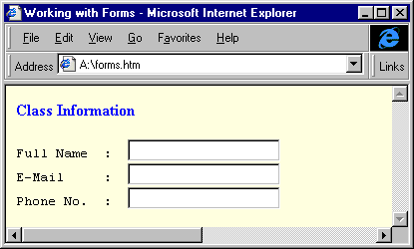
Creating a Text Field

Slide 10
Creating a Radio Button
Syntax: <INPUT type=”radio” …..>
Example:
<HTML>
<TITLE> Working with Forms </TITLE>
<BODY BGCOLOR="lightyellow">
<FORM>
<B><font color="blue"> Class Information</font></B>
<pre>
Full Name : <INPUT type="TEXT" name="fullname" value=" ">
E-Mail : <INPUT type="TEXT" name="email" value=" ">
Phone No. : <INPUT type="TEXT" name="phone" value=" ">
</pre>
<B><font color="blue">Enrollment</font></B>
<BR>In what session are you enrolled?<BR>
<INPUT type="radio" name="session" value="day">Day session
<INPUT type="radio" name="session" value="evening">Evening session
<INPUT type="radio" name="session" value="weekend">Weekend session
</FORM>
</BODY>
</HTML>

Slide 11
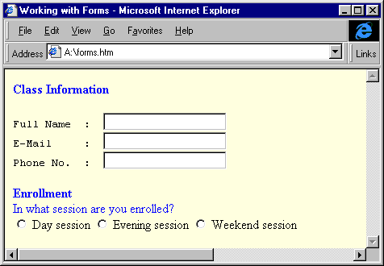
Creating a Radio Button

Slide 12
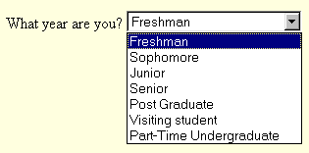
Creating a Popup Menu
Syntax: <SELECT>…</SELECT>
Attributes: NAME and SIZE
Example: Popup Menu
<P>What year are you?
<SELECT NAME="year" SIZE=1>
<OPTION SELECTED> Freshman
<OPTION> Sophomore
<OPTION> Junior
<OPTION> Senior
<OPTION> Post Graduate
<OPTION> Visiting student
<OPTION> Other
</SELECT>

Slide 13
Creating a Scrolled List
Syntax: <SELECT>…</SELECT>
Attributes: NAME, MULTIPLE, and SIZE
Example: Popup Menu
<B><font color=blue> Computer Experience </font></B>
<p>
Select all that apply?
<SELECT NAME="experience" SIZE=5 MULTIPLE>
<OPTION SELECTED> Windows NT
<OPTION> UNIX
<OPTION> HTML
<OPTION> FTP
<OPTION> Archie
<OPTION> Gohper
<OPTION> Newsgroups
</SELECT>

Slide 14
Creating a Checkbox
Syntax: <INPUT type=”checkbox” …..>
Example:
<P><B><font color="blue">Favorites</font></B>
<BR>Select your favorite topic(s)?
<INPUT TYPE="checkbox" name="favorites" value="none"> None<BR>
<INPUT TYPE="checkbox" name="favorites" value="windows"> Windows
<INPUT TYPE="checkbox" name="favorites" value="unix">UNIX
<INPUT TYPE="checkbox" name="favorites" value="web">The Web
<INPUT TYPE="checkbox" name="favorites" value="news">Newsgroups

Slide 15
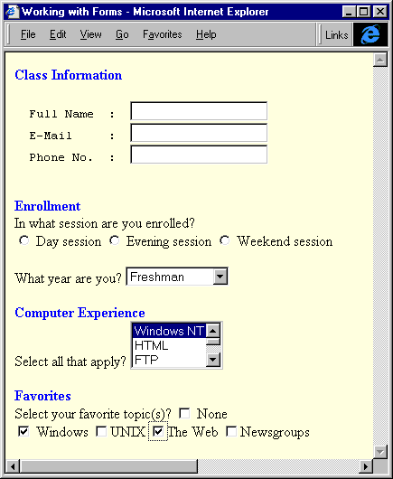
Creating a Checkbox

Slide 16
Creating a Text Area
Syntax: <TEXTAREA> … </TEXTAREA>
Attributes: ROWS, COLS, and NAME.
ROWS: visible number of rows or height of the text area.
COLS: number of visible columns or width of the text area.
NAME is useful when a CGI script is used.
Example:
<P><B><font color="blue">Others</font></B>
<BR>Please type in the text box below if you want to comment?
<TEXTAREA ROWS=“2” COLS=“40” NAME="comments">
</TEXTAREA>

Slide 17
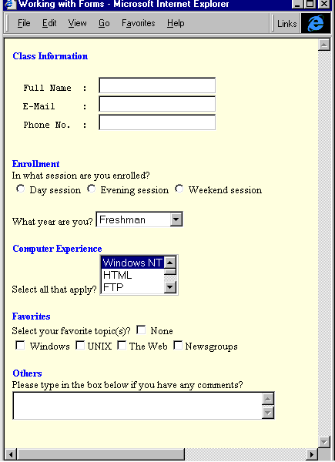
Creating a Text Area

Slide 18
Creating Submit & Reset Buttons
Submit button is used to send and submit the data already entered in the form to the server for processing.
Syntax: <INPUT TYPE=”submit” …..>
Reset button is used to clear the data already entered in the form.
Syntax: <INPUT TYPE=”reset” …..>
<HR>
<INPUT TYPE="submit" NAME="submitbutton" value="Process Data">
<INPUT TYPE="reset" NAME="resetbutton" value="Clear data">
<HR>

Slide 19
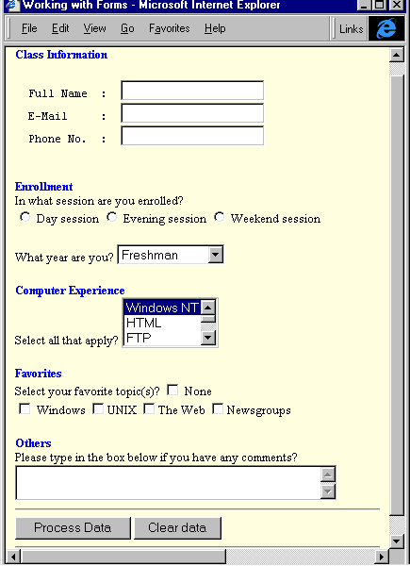
Creating Submit and Reset Buttons

Slide 20
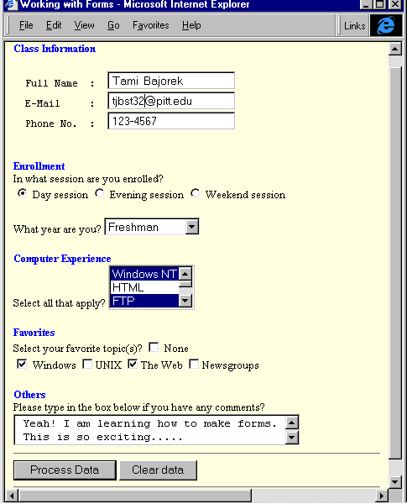
Registration

Slide 21
Password Entry Field
SAMPLE
<p> Enter User Name and Password:</p>
<p>
Username: <input type=“text” size=“30” />
Password: <input type=“password” size=“30” />
</p>

Slide 22
User Submit File
SAMPLE
<p> Use the browse button to select file:</p>
<p>
<input type=“file” size=“30” />
</p>

Slide 23
Image for Submit Button
SAMPLE
<p> Click the image to submit </p>
<input type=“image” src=“van.jpg” alt=“submit button” />

Slide 24
Styling FORM using external CSS
fieldset {
width: 24em;
background-color: #ddeeff;
border: solid medium #05972
}
legend {
border: solid 1px #053972
}

Slide 25
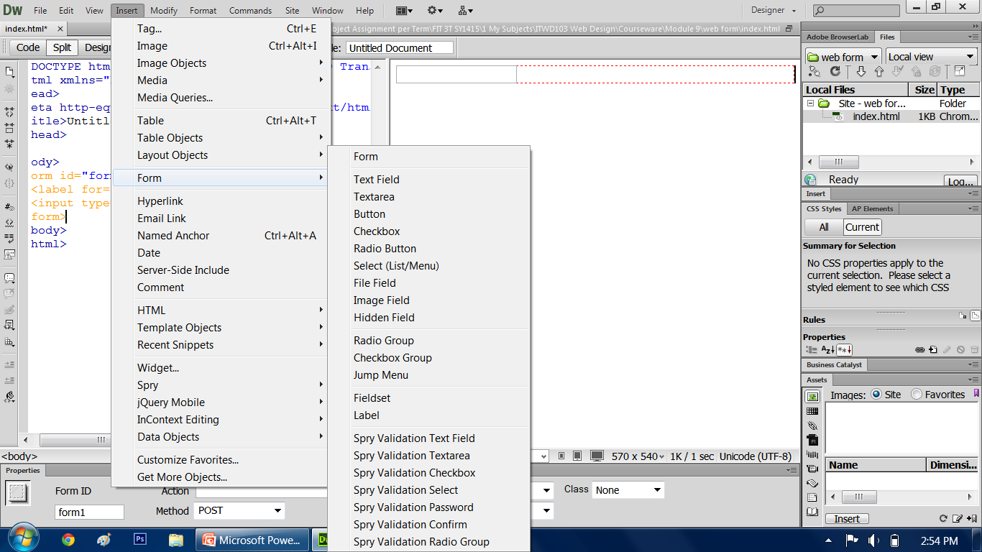
ADOBE DREAMWEAVER

Slide 26
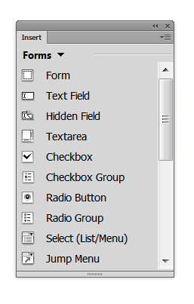
ADOBE DREAMWEAVER

Slide 27
END OF MODULE 8

